Slide 1
hpc Application for Partner enablement
May, 2018

Slide 2
Agenda
Sell GPU in HPC application
How to start for ‘in-house’ code
How to start for open/commercial code
Typical HPC Applications Performance on GPU

Slide 3
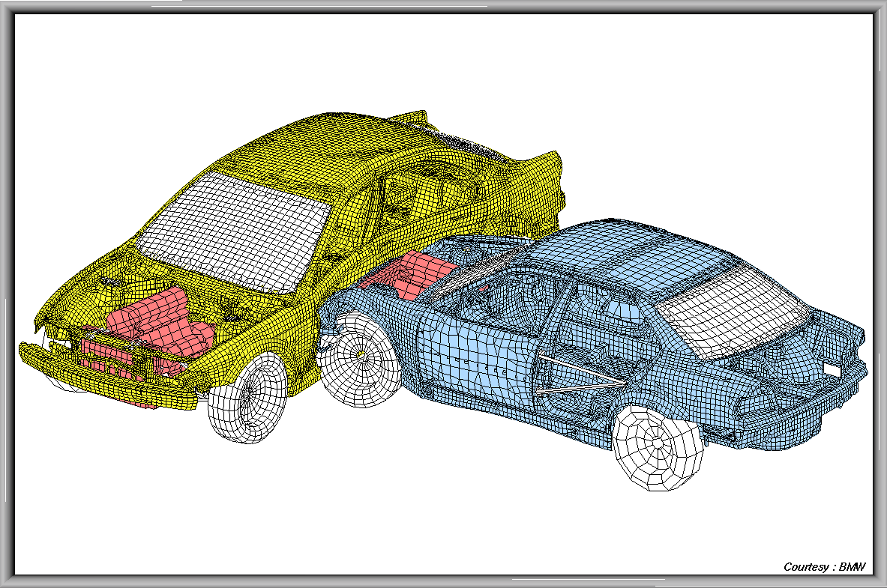

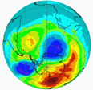
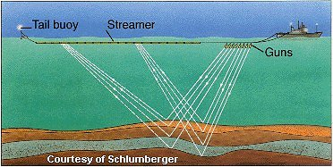
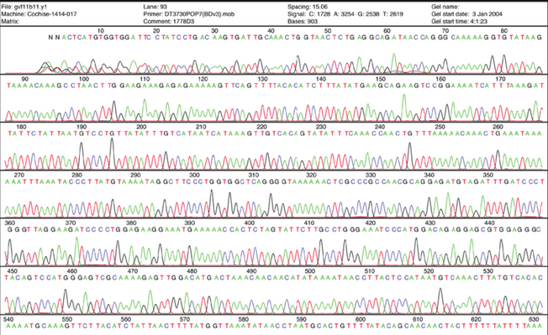


HPC Applications
Astrophysics
Computational Chemistry
Weather Modeling and Climate Prediction
Seismic Analysis
Computational Fluid Dynamics
Crash Analysis
Materials Analysis and Design
Genomics
Translational Medicine
Machine Learning
Cryptography
Financial Risk Analysis
High Performance Analytics
High-Education
Oil & Gas
Weather & Climate
Research Institute
SuperComputer
…
Climate Modeling
Crash Analysis
Weather Prediction
Seismic Analysis
Genomics
Consumer products
Oil & Gas

Slide 4
GPU Target HPC Use Cases
Molecular Dynamics & Quantum Chemistry（８０＋ Ａｐｐ）
超算中心（大学， 研究所， 超算中心）
大学生命科学院，化学， 物理学院（材料科学）
CYR-EM Relion
冷冻电镜项目（生命科学）
Oil&Gas
石油勘探（RTM, FWI)
Lattice-QCD
基础物理核色动力学(Quda， MILC， Chroma）
‘In-house code’(自有代码)
大学，研究所中有自有代码的老师
大规模计算需求
编程能力

Slide 5
What we sell: TESLA V100 32GB & 16GB
Application | Today’s Products | New Deployments | Benefits
DL Training | P100, P40, V100 16GB | V100 32GB | Faster Result with Larger More Complex Models
Memory-Constrained HPC (Seismic, Graphs, CFD, Physics, Climate, Signal Processing, Finance) | K80, P100, V100 16GB | V100 32GB | Faster Results with Large Datasets
Compute-Bound HPC (Life Science, Molecular Dynamics) | K80, P100, V100 16GB | V100 16GB | Higher TCO

Slide 6
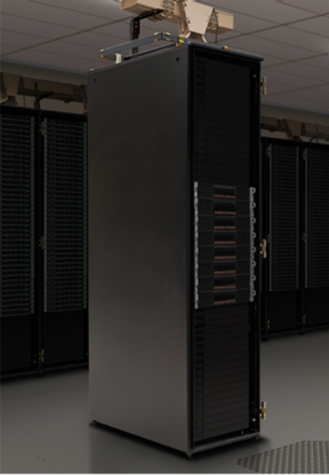
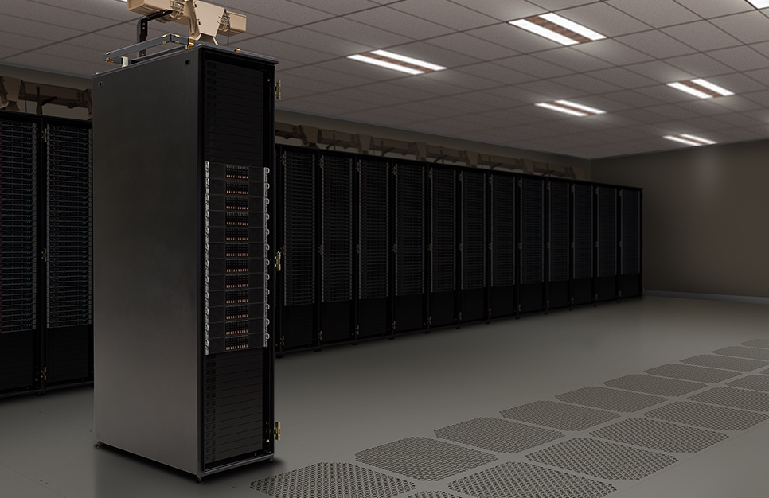
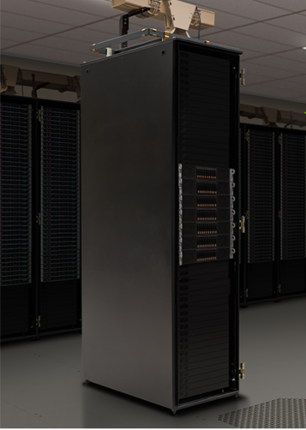
Value to use GPU in HPC
Better HPC TCO for same throughput
Cost
Performance
Power Consumption
Space
Same platform for HPC & AI
Accelerated Computing Trend
GTC ‘18
SAME
THROUGHPUT
1/5
THE COST
1/7
THE SPACE
1/7
THE POWER
MIXED HPC WORKLOAD: Amber, CHROMA, GTC, LAMMPS, MILC, NAMD, Quantum Espresso, SPECFEM3D
8 Accelerated Servers w/4 V100 GPUs
13 KWatts

Slide 7
Agenda
Sell GPU in HPC application
How to start for ‘in-house’ code
How to start for open/commercial code
Typical HPC Applications Performance on GPU

Slide 8
Small Changes, Big Speed-up
Application Code
Rest of Sequential
CPU Code
Compute-Intensive Functions
GPU
Use GPU to Parallelize
CPU
+
Notes:
Your time is precious, which is why performance is critical. So you need to focus on what’s important.
To add GPU acceleration to an application, simply identify and accelerate the *performance-critical areas* in your application.
The rest can run as-is on the CPU. There’s no need for an entire application to be ported to the GPU.
The key point here is that in a hybrid or “heterogeneous” architecture where GPUs and CPUs are working together, developers only need to accelerate performance-critical functions on the GPUs in the system.

Slide 9





Port a ‘in-house’ code to GPU
Analyze
Optimize
Parallelize
9

Slide 10
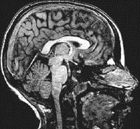
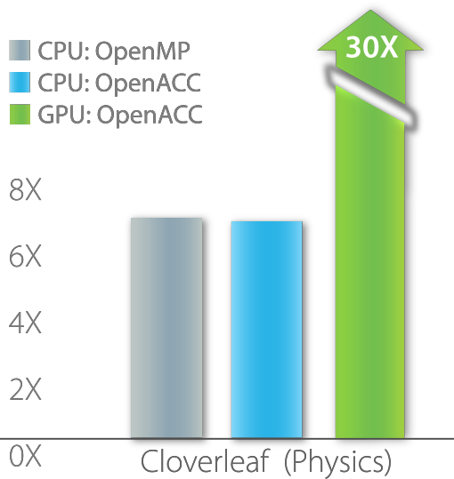

University of Illinois
PowerGrid- MRI Reconstruction
70x Speed-Up
2 Days of Effort
main()
{
<serial code>
#pragma acc kernels
OpenACC
Simple | Powerful | Portable
//automatically runs on GPU
{
<parallel code>
}
}
Fueling the Next Wave of Scientific Discoveries in HPC
RIKEN Japan
NICAM- Climate Modeling
7-8x Speed-Up
5% of Code Modified
http://www.cray.com/sites/default/files/resources/OpenACC_213462.12_OpenACC_Cosmo_CS_FNL.pdf http://www.hpcwire.com/off-the-wire/first-round-of-2015-hackathons-gets-underway http://on-demand.gputechconf.com/gtc/2015/presentation/S5297-Hisashi-Yashiro.pdf http://www.openacc.org/content/experiences-porting-molecular-dynamics-code-gpus-cray-xk7
11

Slide 11
Agenda
Sell GPU in HPC application
How to start for ‘in-house’ code
How to start for open/commercial code
Typical HPC Applications Performance on GPU

Slide 12
GPU-Accelerated HPC applications
500+ APPLICATIONS
Life Sciences
MFG, CAD, & CAE
Physics
OIL & GAS
Climate & WEATHER
DEEP LEARNING
Including:
Gaussian
VASP
AMBER
HOOMD-Blue
GAMESS
111 apps
Including:
Ansys Fluent
Abaqus SIMULIA
AutoCAD
CST Studio Suite
20 apps
17 apps
32 apps
50+ app
Including:
RTM
SPECFEM3D
4 apps
Including:
Cosmos
WRF
Including:
Caffe2
MXNet
Tensorflow
Including:
QUDA
MILC
GTC-P
MEDIA & ENT.
FEDERAL & DEFENSE
DATA SCI. & analytics
SAFETY & SECURITY
COMP.
Finance
TOOLS & MGMT.
142 apps
Including:
DaVinci Resolve
Premiere Pro CC
Redshift Renderer
13 apps
Including:
ArcGIS Pro
EVNI
SocetGXP
23
apps
15 apps
Including:
Cyllance
FaceControl
Syndex Pro
16 apps
Including:
O-Quant Options Pricing
MUREX
MISYS
15 apps
Including:
Bright Cluster Manager
HPCtoolkit
Vampir
Including:
MapD
Kinetica
Graphistry

Slide 13
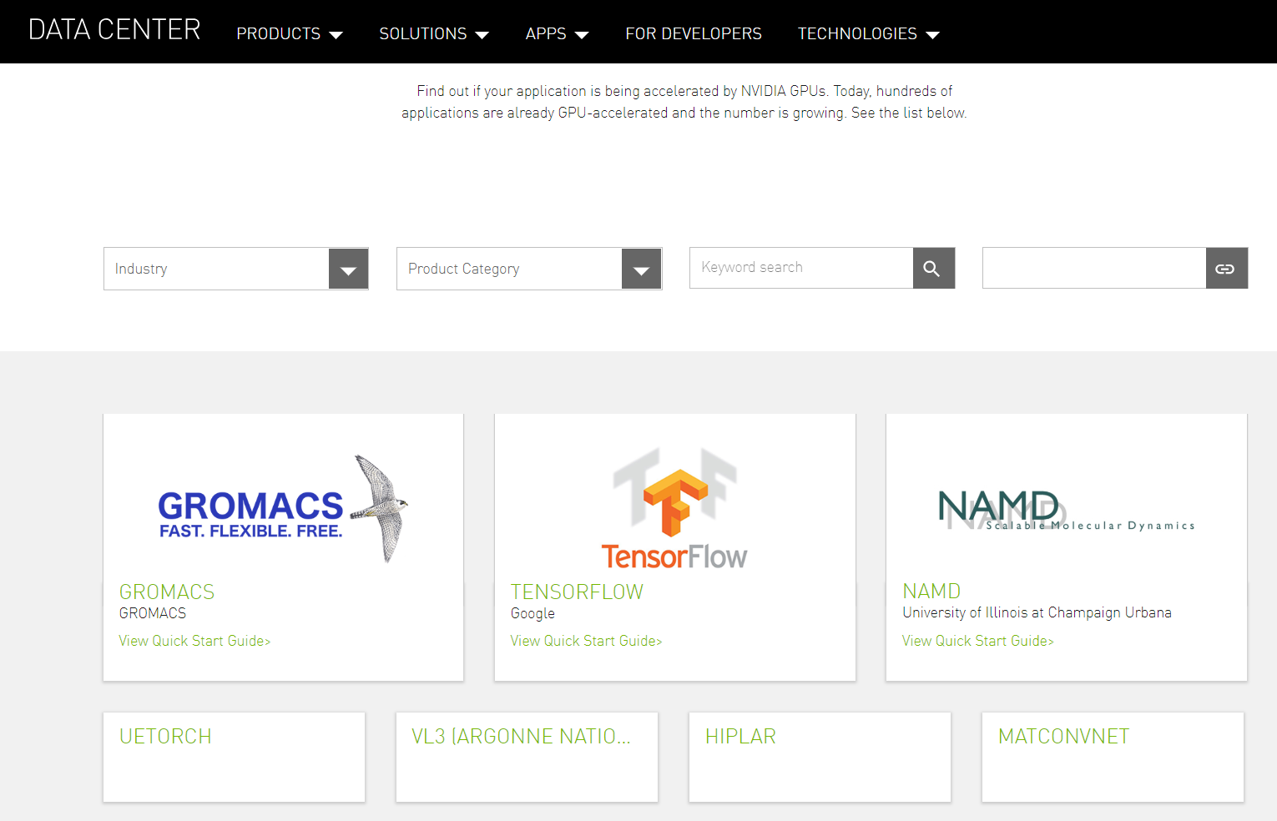
NVIDIA GPU-Accelerated Application Catalog
https://www.nvidia.com/en-us/data-center/gpu-accelerated-applications/catalog/

Slide 14
Agenda
Sell GPU in HPC application
How to start for ‘in-house’ code
How to start for open/commercial code
Typical HPC Applications Performance on GPU

Slide 15
HPC Application Performance
Molecular Dynamics & Quantum Chemistry
CRY-EM - Rellion
PHISICS - LQCD
Geo-Science
Engineering
Computational Finance
Benchmarks

Slide 16
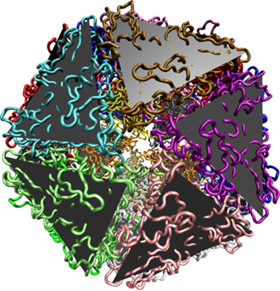
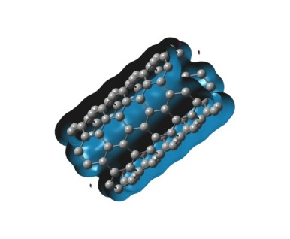
80+ MD&QC Accelerated Apps
MD: All key codes are GPU-accelerated
Great multi-GPU performance
Focus on dense (up to 16) GPU nodes &/or large # of GPU nodes
ACEMD*, AMBER (PMEMD)*, BAND, CHARMM, DESMOND, ESPResso, Folding@Home, GPUgrid.net, GROMACS, HALMD, HOOMD-Blue*, LAMMPS, Lattice Microbes*, mdcore, MELD, miniMD, NAMD, OpenMM, PolyFTS, SOP-GPU* & more
QC: All key codes are ported or optimizing
Focus on using GPU-accelerated math libraries, OpenACC directives
GPU-accelerated and available today:
ABINIT, ACES III, ADF, BigDFT, CP2K, GAMESS, GAMESS-UK, GPAW, Gaussian, LATTE, LSDalton, LSMS, MOLCAS, MOPAC2012, NWChem, OCTOPUS*, PEtot, QUICK, Q-Chem, QMCPack, Quantum Espresso/PWscf, QUICK, TeraChem*, VASP
Active GPU acceleration projects:
CASTEP, ONETEP, Quantum Supercharger Library* & more
green* = application where >90% of the workload is on GPU

Slide 17

GPU-Accelerated Molecular Dynamics Apps
Green Lettering Indicates Performance Slides Included
ACEMD
AMBER
CHARMM
DESMOND
ESPResSO
Folding@Home
Genesis
GPUGrid.net
GROMACS
HALMD
HOOMD-Blue
LAMMPS
mdcore
MELD
NAMD
OpenMM
PolyFTS
GPU Perf compared against dual multi-core x86 CPU socket.

Slide 18
AMBER Performance Equivalency
Single GPU Server vs Multiple Skylake CPU-Only Servers
SKL/V100 #’s may change
AMBER
Molecular Dynamics
Suite of programs to simulate molecular dynamics on biomolecule
VERSION
16.12
ACCELERATED FEATURES
PMEMD Explicit Solvent & GB; Explicit & Implicit Solvent, REMD, aMD
SCALABILITY
Multi-GPU and Single-Node
MORE INFORMATION
http://ambermd.org/gpus
# of CPU Only Servers
191 CPU Servers
95 CPU Servers
48 CPU Servers
1 server
2x V100 GPUs
1 server
4x V100 GPUs
1 server
8x V100 GPUs
Speed up vs CPU server
30x
59x
119x
CPU Server: Dual Xeon Gold 6140@2.30GHz, GPU Servers: same CPU server w/ V100 PCIe or V100 SXM2
CUDA Version: CUDA 9.0.176; Dataset: PME-Cellulose_NVE
To arrive at CPU node equivalence, we use measured benchmark with up to 8 CPU nodes. Then we use linear scaling to scale beyond 8 nodes.

Slide 19
HOOMD-Blue Performance Equivalency
Single GPU Server vs Multiple Broadwell CPU-Only Servers
HOOMD-Blue
Molecular Dynamics
Particle dynamics package written grounds up for GPUs
VERSION
2.2.2
ACCELERATED FEATURES
CPU & GPU versions available
SCALABILITY
Multi-GPU and Multi-Node
MORE INFORMATION
http://codeblue.umich.edu/hoomd-blue/index.html
# of CPU Only Servers
54 CPU Servers
43 CPU Servers
34 CPU Servers
1 server
2x V100 GPUs
1 server
4x V100 GPUs
1 server
8x V100 GPUs
Speed up vs CPU server
30x
38x
47x
CPU Server: Dual Xeon E5-2690 v4@2.6GHz, GPU Servers: same CPU server w/ V100 PCIe
CUDA Version: CUDA 9.0.176; Dataset: microsphere
To arrive at CPU node equivalence, we use measured benchmark with up to 8 CPU nodes. Then we use linear scaling to scale beyond 8 nodes.

Slide 20
LAMMPS Performance Equivalency
Single GPU Server vs Multiple Skylake CPU-Only Servers
LAMMPS
Molecular Dynamics
Classical molecular dynamics package
VERSION
2018
ACCELERATED FEATURES
Lennard-Jones, Gay-Berne, Tersoff, many more potentials
SCALABILITY
Multi-GPU and Multi-Node
More Information
http://lammps.sandia.gov/index.html
# of CPU Only Servers
22 CPU Servers
15 CPU Servers
9 CPU Servers
1 server
2x V100 GPUs
1 server
4x V100 GPUs
1 server
8x V100 GPUs
Speed up vs CPU server
9x
15x
21x
CPU Server: Dual Gold 6140@2.30GHz, GPU Servers: same CPU server w/ V100 PCIe or V100
CUDA Version: CUDA 9.0.176, Dataset: Atomic-Fluid Lennard-Jones 2.5 Cutoff
To arrive at CPU node equivalence, we use measured benchmark with up to 8 CPU nodes. Then we use linear scaling to scale beyond 8 nodes.

Slide 21
NAMD Performance Equivalency
Single GPU Server vs Multiple Skylake CPU-Only Servers
NAMD
Geoscience (Oil & Gas)
Designed for high-performance simulation
of large molecular systems
VERSION
2.13
ACCELERATED FEATURES
Full electrostatics with PME and most simulation features
SCALABILITY
Up to 100M atom capable, multi-GPU, Scale Scales to 2xP100
More Information
http://www.ks.uiuc.edu/Research/namd/
# of CPU Only Servers
14 CPU Servers
11 CPU Servers
1 server
2x V100 GPUs
1 server
4x V100 GPUs
Speed up vs CPU server
9x
12x
CPU Server: Dual Xeon Gold 6140@2.30GHz, GPU Servers: same CPU server w/ V100 PCIe
CUDA Version: CUDA 9.0.176, Dataset: STMV
To arrive at CPU node equivalence, we use measured benchmark with up to 8 CPU nodes. Then we use linear scaling to scale beyond 8 nodes.

Slide 22
GROMACS Water 1.5M on V100 vs P100 (PCIe 16GB)
4.9X
4.3X
4.3X
(Untuned on Volta)
Running GROMACS version 2018
The blue node contains Dual Intel Xeon E5-2690 v4@2.6GHz [3.5GHz Turbo] (Broadwell) CPUs
The green nodes contain Dual Intel Xeon E5-2690 v4@2.6GHz [3.5GHz Turbo] (Broadwell) CPUs + Tesla P100 PCIe (16GB) or V100 PCIe
(16GB) GPUs
4.0X
3.5X
2.5X

Slide 23
GPU-Accelerated Quantum Chemistry Apps
Green Lettering Indicates Performance Slides Included
Abinit
ACES III
ADF
BigDFT
CP2K
DIRAC
GAMESS-US
Gaussian
GPAW
FHI-AIMS
LATTE
LSDalton
MOLCAS
Mopac2012
NWChem
Octopus
ONETEP
Petot
Q-Chem
QMCPACK
Quantum Espresso
Quantum SuperCharger Library
RMG
TeraChem
UNM
VASP
WL-LSMS
GPU Perf compared against dual multi-core x86 CPU socket.

Slide 24
Quantum Espresso
Performance Equivalency
Single GPU Server vs Multiple Skylake CPU-Only Servers
Quantum Espresso
Material Science (Quantum Chemistry)
An Open-source suite of computer codes for electronic structure calculations and materials modeling at the nanoscale.
VERSION
6.2.1
ACCELERATED FEATURES
Linear algebra (matix multiply), explicit computational kernels, 3D FFTs
SCALABILITY
Multi-GPU and Multi-Node
MORE INFORMATION
http://www.quantum-espresso.org
# of CPU Only Servers
13 CPU Servers
7 CPU Servers
1 server
2x V100 GPUs
1 server
4x V100 GPUs
Speed up vs CPU server
4x
8x
CPU Server: Dual Xeon Gold 6140@2.30GHz, GPU Servers: same CPU server w/ V100 PCIe
CUDA Version: CUDA 9.0.176; Dataset: AUSURF112-jR
To arrive at CPU node equivalence, we use measured benchmark with up to 8 CPU nodes. Then we use linear scaling to scale beyond 8 nodes.

Slide 25
Gaussian 16
Mike Frisch, Ph.D.
President and CEO
Gaussian, Inc.
A Leading Computation Chemistry Code
“
Using OpenACC allowed us to continue development of our fundamental algorithms and software capabilities simultaneously with the GPU-related work. In the end, we could use the same code base for SMP, cluster/ network and GPU parallelism. PGI's compilers were essential to the success of our efforts.
Valinomycin Frequency. APFD 6-311+G(2d,p) 7X speedup on 8X P100 GPUs
Hardware: HPE Apollo 6500 server with dual Intel Xeon E5-2680 v4 CPUs (2.40GHz; 14 cores/chip, 28 cores total), 256GB memory and 8 Tesla P100 GPU boards (autoboost clocks). Gaussian source code compiled with PGI Accelerator Compilers (17.7) with OpenACC (2.5 standard).
“

Slide 26
Gaussian 16 P100 PerFormance
Dual-socket 28-core Broadwell vs 8x P100 GPUs

Slide 27
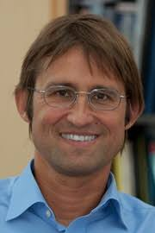
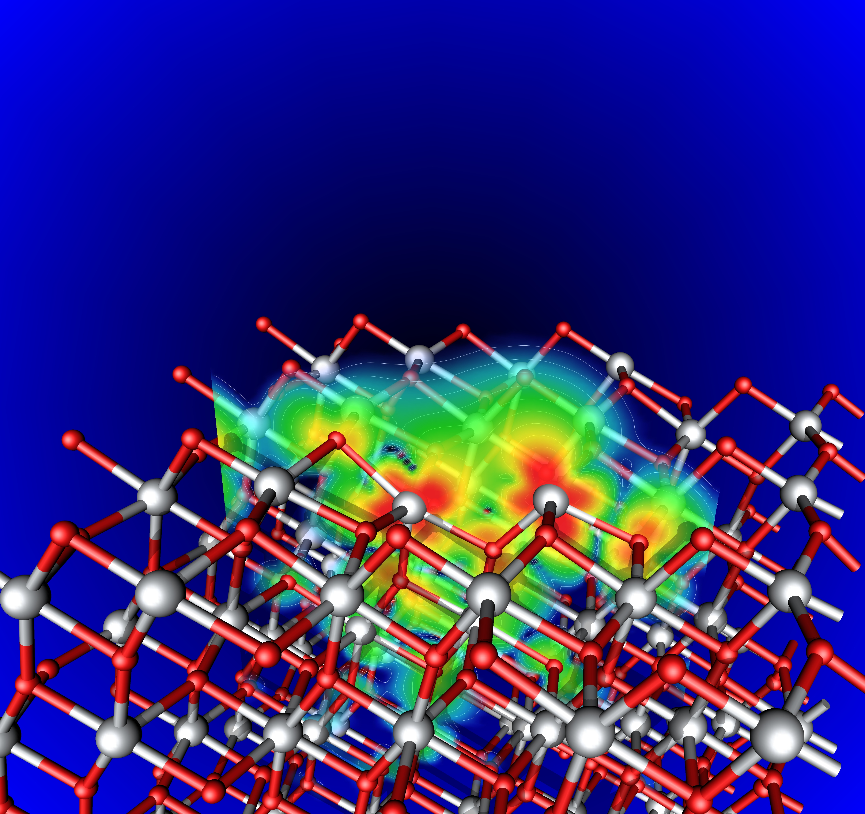
VASP
Photo
Prof. Georg Kresse
Computational Materials Physics University of Vienna
The Vienna Ab Initio Simulation Package
“
For VASP, OpenACC is the way forward for GPU acceleration. Performance is similar to CUDA, and OpenACC dramatically decreases GPU development and maintenance efforts. We’re excited to collaborate with NVIDIA and PGI as an early adopter of Unified Memory.
“
Notes:
This quote has NOT BEEN APPROVED YET, draft only !
VASP developers impressed by performance/maintainability of OpenACC
Two new VASP features have already been completed with OpenACC
Integrating OpenACC into production VASP source base
Plans to GPU accelerate more solvers and features using OpenACC

Slide 28
B.aP107 on V100s PCIe
(Untuned on Volta)
Running VASP version 5.4.4
The blue node contains Dual Intel Xeon E5-2690 v4@2.6GHz [3.5GHz Turbo] (Broadwell) CPUs
The green nodes contain Dual Intel Xeon E5-2690 v4@2.6GHz [3.5GHz Turbo] (Broadwell) CPUs +
Tesla V100 PCIe (16GB) GPUs
107 Boron atoms (symmetry broken 107-atom β′ variant)
216 bands
110592 plane waves
Hybrid functional calculation (exact exchange) with blocked Davidson. No KPoint parallelization.
Hybrid Functional with blocked Davidson (ALGO=Normal)
LHFCALC=.True. (Exact Exchange)
12.9X
12.2X
8.5X

Slide 29
Silica IFPEN on V100s PCIe
(Untuned on Volta)
Running VASP version 5.4.4
The blue node contains Dual Intel Xeon E5-2690 v4@2.6GHz [3.5GHz Turbo] (Broadwell) CPUs
The green nodes contain Dual Intel Xeon E5-2690 v4@2.6GHz [3.5GHz Turbo] (Broadwell) CPUs +
Tesla V100 PCIe (16GB) GPUs
240 ions, cristobalite (high) bulk
720 bands
? plane waves
ALGO = Very Fast (RMM-DIIS)
3.0X
2.6X
2.0X

Slide 30
Cry-em Rellion

Slide 31
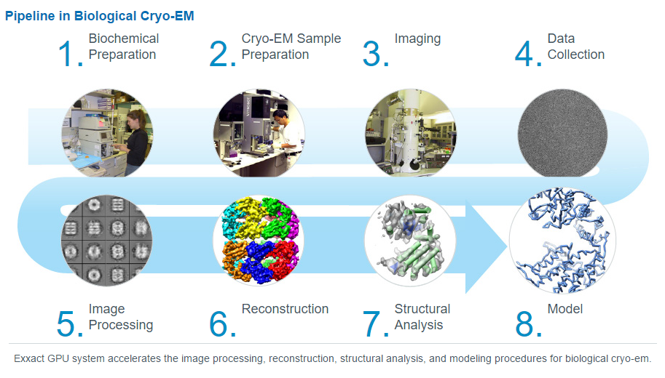

Slide 32
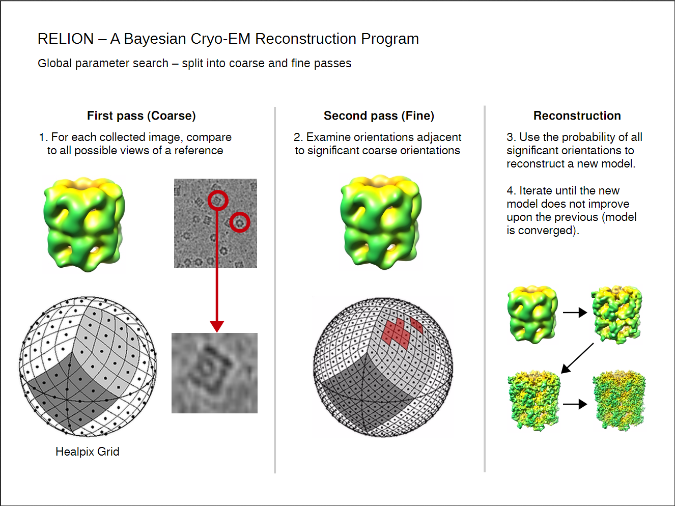

Slide 33
RELION: Plasmodium ribosome on P100s PCIe
40.0X
Running RELION version 2.0.3
The blue node contains Dual Intel Xeon E5-2690 v4@2.6GHz (Broadwell) CPUs
The green nodes contain Dual Intel Xeon E5-2690 v4@2.6GHz (Broadwell) CPUs + Tesla P100 PCIe (16GB) GPUs
Data Citation: http://en.community.dell.com/techcenter/high-performance-computing/b/general_hpc/archive/2017/03/14/application-performance-on-p100-pcie-gpus
37.3X
33.7X
23.3X
15.3X
9.0X

Slide 34
Physics

Slide 35
Chroma Performance Equivalency
Single GPU Server vs Multiple Skylake CPU-Only Servers
# of CPU Only Servers
13 CPU Servers
Chroma
Physics
Lattice Quantum Chromodynamics (LQCD)
VERSION
2018
ACCELERATED FEATURES
Wilson-clover fermions, Krylov solvers, Domain-decomposition
SCALABILITY
Multi-GPU
MORE INFORMATION
http://jeffersonlab.github.io/chroma/
6 CPU Servers
1 server
2x V100 GPUs
1 server
4x V100 GPUs
Speed up vs CPU server
6x
16x
CPU Server: Dual Xeon Gold 6140@2.30GHz, GPU Servers: same CPU server w/ V100 PCIe
CUDA Version: CUDA 9.0.176; Dataset: szscl21_24_128
To arrive at CPU node equivalence, we use measured benchmark with up to 8 CPU nodes. Then we use linear scaling to scale beyond 8 nodes.

Slide 36
MILC Performance Equivalency
Single GPU Server vs Multiple Skylake CPU-Only Servers
MILC
Physics
Lattice Quantum Chromodynamics (LQCD) codes simulate how elemental particles are formed and bound by the “strong force” to create larger particles like protons and neutrons
VERSION
2018
ACCELERATED FEATURES
Staggered fermions, Krylov solvers, Gauge-link fattening
SCALABILITY
Multi-GPU and Multi-Node
MORE INFORMATION
www.nvidia.com/milc
# of CPU Only Servers
28 CPU Servers
15 CPU Servers
1 server
2x V100 GPUs
1 server
4x V100 GPUs
Speed up vs CPU server
14x
27x
CPU Server: Dual Xeon Gold 6140@2.30GHz, GPU Servers: Dual Xeon Gold 6140@2.30GHz with Tesla V100 PCIe (16GB)
CUDA Version: CUDA 9.0.176; Dataset: MILC APEX Medium
To arrive at CPU node equivalence, we use measured benchmark with up to 8 CPU nodes. Then we use linear scaling to scale beyond 8 nodes.

Slide 37
QUDA Performance Equivalency
Single GPU Server vs Multiple Broadwell CPU-Only Servers
No change
# of CPU Only Servers
74 CPU Servers
68 CPU Servers
QUDA
Physics
A library for Lattice Quantum Chromo Dynamics on GPUs
VERSION
2017
ACCELERATED FEATURES
All
SCALABILITY
Multi-GPU and Multi-Node
MORE INFORMATION
www.nvidia.com/quda
38 CPU Servers
1 server
2x V100 GPUs
1 server
4x V100 GPUs
1 server
8x V100 GPUs
Speed up vs CPU server
29x
51x
56x
CPU Server: Dual Xeon E5-2690 v4@2.6GHz, GPU Servers: same CPU server w/ V100 PCIe
CUDA 9.0.103; Dataset: Dslash Wilson-Clover; Precision: Single; Gauge Compression/Recon: 12;
Problem Size 32x32x32x64
To arrive at CPU node equivalence, we use measured benchmark with up to 8 CPU nodes. Then we use linear scaling to scale beyond 8 nodes.

Slide 38
GTC Performance Equivalency
Single GPU Server vs Multiple Skylake CPU-Only Servers
# of CPU Only Servers
18 CPU Servers
GTC
Physics
GTC is used for Gyrokinetic Particle Simulation of Turbulent Transport in Burning Plasmas.
VERSION
2017
ACCELERATED FEATURES
Push, shift, and collision
SCALABILITY
Multi-GPU
MORE INFORMATION
www.nvidia.com/gtc-p
9 CPU Servers
1 server
2x V100 GPUs
1 server
4x V100 GPUs
Speed up vs CPU server
9x
16x
CPU Server: Dual Xeon Gold 6140@2.30GHz, GPU Servers: same CPU server w/ V100 PCIe
CUDA Version: CUDA 9.0.176; Dataset: mpi#proc.in
To arrive at CPU node equivalence, we use measured benchmark with up to 8 CPU nodes. Then we use linear scaling to scale beyond 8 nodes.

Slide 39
Geoscience

Slide 40
Speed-up slight change, rounded up old raw data
RTM Performance Equivalency
Single GPU Server vs Multiple Broadwell CPU-Only Servers
# of CPU Only Servers
16 CPU Servers
RTM
Geoscience (Oil & Gas)
Reverse time migration (RTM) modeling is a critical component in the seismic processing workflow of oil and gas exploration
VERSION
2017
ACCELERATED FEATURES
Batch algorithm
SCALABILITY
Multi-GPU and Multi-Node
11 CPU Servers
6 CPU Servers
1 server
2x V100 GPUs
1 server
4x V100 GPUs
1 server
8x V100 GPUs
Speed up vs CPU server
5x
10x
15x
CPU Server: Dual Xeon E5-2690 v4@2.6GHz, GPU Servers: same CPU server w/ V100 PCIe
CUDA Version: CUDA 9.0.103; Dataset: TTI RX 2pass mgpu
To arrive at CPU node equivalence, we use linear scaling to scale beyond 1 nodes.

Slide 41
SPECFEM3D Performance Equivalency
Single GPU Server vs Multiple Skylake CPU-Only Servers
# of CPU Only Servers
54 CPU Servers
SPECFEM3D
Geoscience
Simulates Seismic wave propagation
VERSION
2.0.2
SCALABILITY
Multi-GPU and Single-Node
MORE INFORMATION
https://geodynamics.org/cig/software/specfem3d_globe/
28 CPU Servers
1 server
2x V100 GPUs
1 server
4x V100 GPUs
Speed up vs CPU server
27x
52x
CPU Server: Dual Xeon Gold 6140@2.30GHz, GPU Servers: same CPU server w/ V100 PCIe
CUDA Version: CUDA 9.0.176; Dataset: four_material_simple_model​
To arrive at CPU node equivalence, we use linear scaling to scale beyond 1 nodes.

Slide 42
engineering

Slide 43
SIMULIA Abaqus Performance Equivalency
Single GPU Server vs Multiple Broadwell CPU-Only Servers
Speed-up slight change, rounded up old raw data
SIMULIA Abaqus
Engineering
Simulation tool for analysis of structures
VERSION
2017
ACCELERATED FEATURES
Direct Sparse Solver
AMS Eigen Solver
Steady-state Dynamics Solver
SCALABILITY
Multi-GPU and Multi-Node
MORE INFORMATION
http://www.nvidia.com/simulia-abaqus
# of CPU Only Servers
4 CPU Servers
3 CPU Servers
1 server
2x V100 GPU’s
1 server
4x V100 GPU’s
Speed up vs CPU server
2.2x
2.4x
CPU Server: Dual Xeon E5-2690 v4@2.6GHz, GPU Servers: same CPU server w/ V100 PCIe
CUDA Version: CUDA 7.5; Dataset: LS-EPP-Combined-WC-Mkl (RR)
To arrive at CPU node equivalence, we use measured benchmark with up to 8 CPU nodes. Then we use linear scaling to scale beyond 8 nodes.

Slide 44
ANSYS Fluent Performance Equivalency
Single GPU Server vs Multiple Broadwell CPU-Only Servers
# of CPU Only Servers
ANSYS Fluent
Engineering
General purpose software for the simulation of fluid dynamics
VERSION
18
ACCELERATED FEATURES
Pressure-based Coupled Solver and Radiation Heat Transfer
SCALABILITY
Multi-GPU and Multi-Node
MORE INFORMATION
http://www.nvidia.com/ansys-fluent
4 CPU Servers
3 CPU Servers
1 server
2x V100 GPUs
1 server
4x V100 GPUs
Speed up vs CPU server
2x
3x
CPU Server: Dual Xeon E5-2690 v4@2.6GHz, GPU Servers: same CPU server w/ V100 PCIe
CUDA Version: CUDA 6.0; Dataset: Water Jacket
To arrive at CPU node equivalence, we use measured benchmark with up to 8 CPU nodes. Then we use linear scaling to scale beyond 8 nodes.

Slide 45
Computational finance
Notes:
TESLA V100 PERFORMANCE GUIDE
COMPUTATIONAL FINANCE
Computational Finance applications are essential to the success of global financial service firms to perform market and counterparty risk analytics, asset pricing, and portfolio risk management analysis. This analysis requires numerical methods that are computationally intensive. Several of the leading computational finance applications are GPU-accelerated. For financial analysis, time is money. Computational Finance applications using Tesla V100 GPUs can improve performance by over 50X and 80% in server and infrastructure acquisition costs.
KEY FEATURES OF THE TESLA PLATFORM AND V100 FOR COMPUTATIONAL FINANCE
> Servers with V100 outperform CPU servers by up to 8.9X based on STAC-A2 benchmark results
> Top Computational Finance applications are GPU-accelerated
Up to 15.7 TFLOPS of single precision floating point performance per GPU
Up to 32 GB of memory capacity per GPU
Up to 900 GB/s memory bandwidth per GPU
View additional information at:
https://www.nvidia.com/en-us/data-center/gpu-accelerated-applications/catalog/

Slide 46
STAC-A2 Benchmark Performance Results
8 x V100 GPU Server vs Dual Skylake Platinum 8180 Sever
STAC-A2
Computational Finance
Financial risk management benchmark created by leading global banks working with the Securities Technology Analysis Center (STAC) used to assess financial compute solutions.
VERSION
STAC-A2 (Beta 2)
ACCELERATED FEATURES
Full framework accelerated
SCALABILITY
Multi-GPU
More Information
www.STACresearch.com/nvidia
8.9x
6.2x
2.9x
System Configuration: GPU Server SUT ID: NVDA171020 | STAC-A2 Pack for CUDA (Rev D) | GPU Server: 8 x NVIDIA Tesla V100 (Volta) GPU,2 x Intel® Xeon E5-2680 v4 @ 2.4 GHz | CUDA Version 9.0 | Compared to: CPU Server SUT ID: INTC170920, | STAC-A2 Pack for Intel Composer XE (Rev K) | 2 x 28-Core Intel Xeon Platinum 8180 @ 2.5GHz
“Throughput” is STAC-A2.β2.HPORTFOLIO.SPEED, “Latency” is STAC-A2.β2.GREEKS.WARM, and “Energy Efficiency” is STAC-A2.β2.ENERG_EFF.|“STAC” and all STAC names are trademarks or registered trademarks of the Securities Technology Analysis Center, LLC.

Slide 47
Benchmarks

Slide 48
HPCG Performance Equivalency
Single GPU Server vs Multiple Broadwell CPU-Only Servers
# of CPU Only Servers
66 CPU Servers
HPCG
Benchmark
Exercises computational and data access patterns that closely match a broad set of important HPC applications
VERSION
3
ACCELERATED FEATURES
All
SCALABILITY
Multi-GPU and Multi-Node
MORE INFORMATION
http://www.hpcg-benchmark.org/index.html
36 CPU Servers
19 CPU Servers
1 server
2x V100 GPUs
1 server
4x V100 GPUs
1 server
8x V100 GPUs
Speed up vs CPU server
18x
36x
65x
CPU Server: Dual Xeon E5-2690 v4@2.6GHz, GPU Servers: same CPU server w/ V100 PCIe
CUDA Version: CUDA 9.0.103; Dataset: 256x256x256 local size
To arrive at CPU node equivalence, we use measured benchmark with up to 8 CPU nodes. Then we use linear scaling to scale beyond 8 nodes.

Slide 49
Linpack Performance Equivalency
Single GPU Server vs Multiple S Skylake CPU-Only Servers
# of CPU Only Servers
11 CPU Servers
Linpack
Benchmark
Measures floating point computing power
VERSION
2.1
ACCELERATED FEATURES
All
SCALABILITY
Multi-GPU and Multi-Node
MORE INFORMATION
https://www.top500.org/project/linpack/
6 CPU Servers
1 server
2x V100 GPUs
1 server
4x V100 GPUs
Speed up vs CPU server
9x
18x
22x
CPU Server: Dual Xeon Gold 6140@2.30GHz, GPU Servers: same CPU server w/ V100 PCIe
CUDA Version: CUDA 9.0.103; Dataset: HPL.dat
To arrive at CPU node equivalence, we use measured benchmark with up to 8 CPU nodes. Then we use linear scaling to scale beyond 8 nodes.

Slide 50
Dig out the application list for what is running on your customer’s HPC cluster.
Find the open/commercial application in NVIDIA App Catalog.
For in-house application, influence the customer to try GPU technology by using OpenACC, it is simple, portable and powerful.
Call for Actions
Notes:
Years Ahead of Industry
Lead

Slide 51
NVIDIA China HPC Contacts
HPC Sales IBD
HER:
David Yuan <dayuan@nvidia.com>
Charlie Liu <charliel@nvidia.com>
O&G, CAS, Weather and Supercompute:
Jason Guo <jasong@nvidia.com>
HPC Solution Architect:
Cheng Yi <chengyi@nvidia.com>
Qingping Fu <qfu@nvidia.com>
Tao Zhao <tazhao@nvidia.com>
HPC Application DevRel:
Shun Li <shunl@nvidia.com>
DevTech
…

